Slide 1
Multi-Class and Structured Classification
Simon Lacoste-Julien
Machine Learning Workshop
Friday 8/24/07
[built from slides from Guillaume Obozinksi]

Slide 2




Basic Classification in ML
Input
Output
Spam
filtering
Binary
!!!!$$$!!!!
Multi-Class
Character
recognition
C
[thanks to Ben Taskar for slide!]

Slide 3





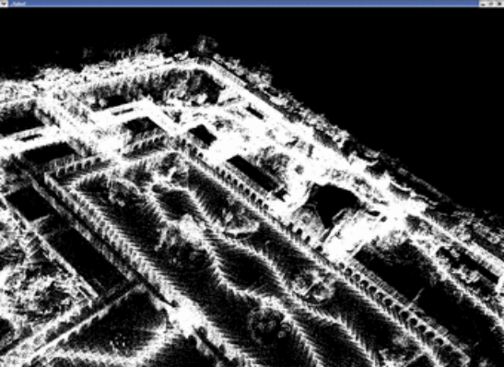
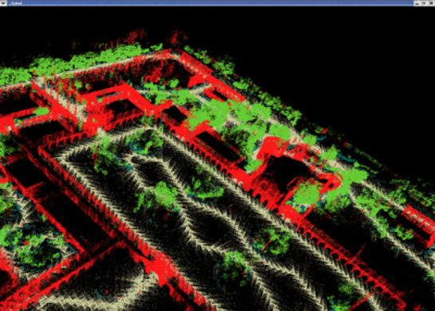
Structured Classification
Input
Output
Handwriting
recognition
Structured output
brace
3D object
recognition
building
tree
[thanks to Ben Taskar for slide!]

Slide 4
Multi-Class Classification
Multi-class classification : direct approaches
  Nearest Neighbor
  Generative approach & Naïve Bayes
  Linear classification:
    geometry
    Perceptron
    K-class (polychotomous) logistic regression
    K-class SVM
Multi-class classification through binary classification
  One-vs-All
  All-vs-all
  Others
  Calibration

Slide 5
Multi-label classification
  Is it eatable?
  Is it sweet?
  Is it a fruit?
  Is it a banana?
Is it a banana?
Is it an apple?
Is it an orange?
Is it a pineapple?
Is it a banana?
Is it yellow?
Is it sweet?
Is it round?
Different structures
Nested/ Hierarchical
Exclusive/ Multi-class
General/Structured

Slide 6
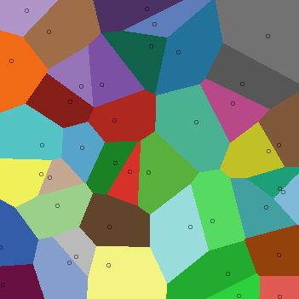
Nearest Neighbor,
Decision Trees
- From the classification lecture:
NN and k-NN were already phrased in a multi-class framework
For decision tree, want purity of leaves depending on the proportion of each class (want one class to be clearly dominant)

Slide 7
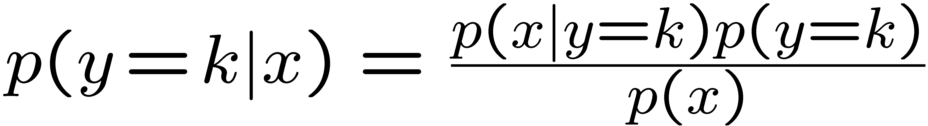
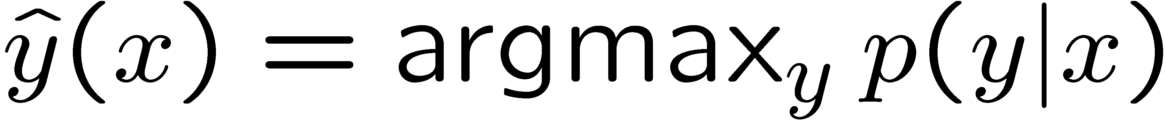
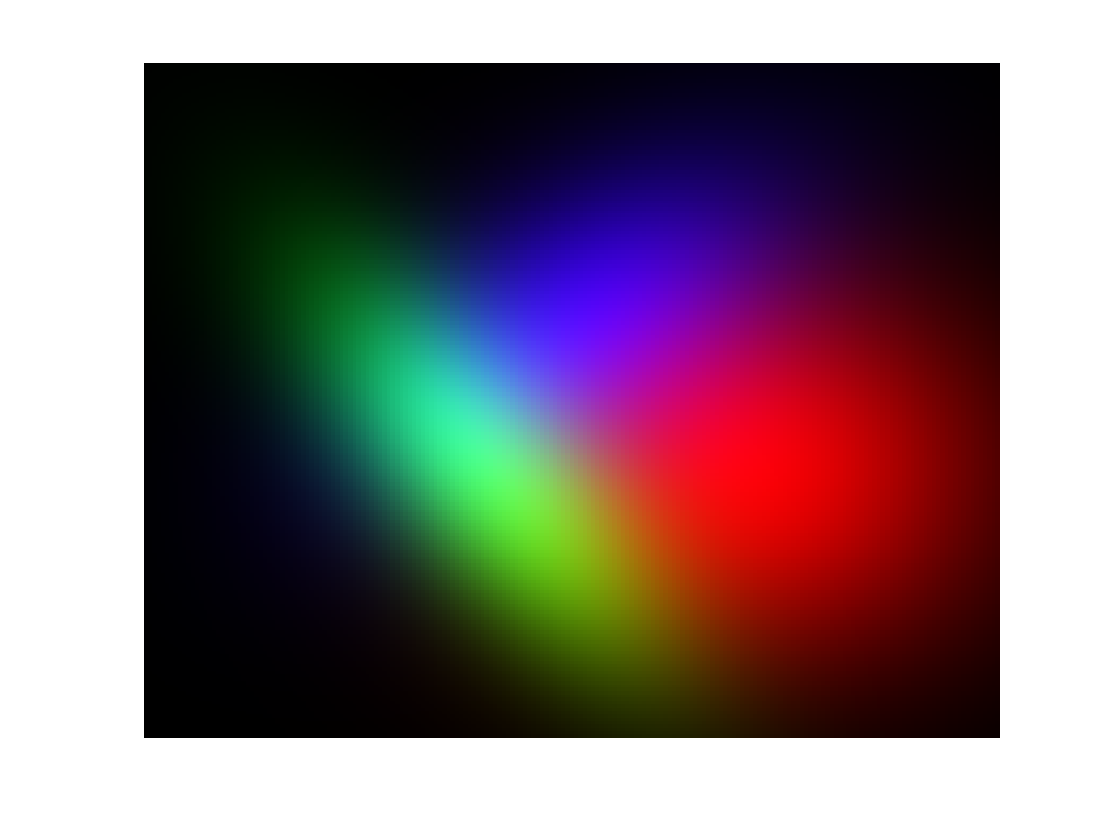
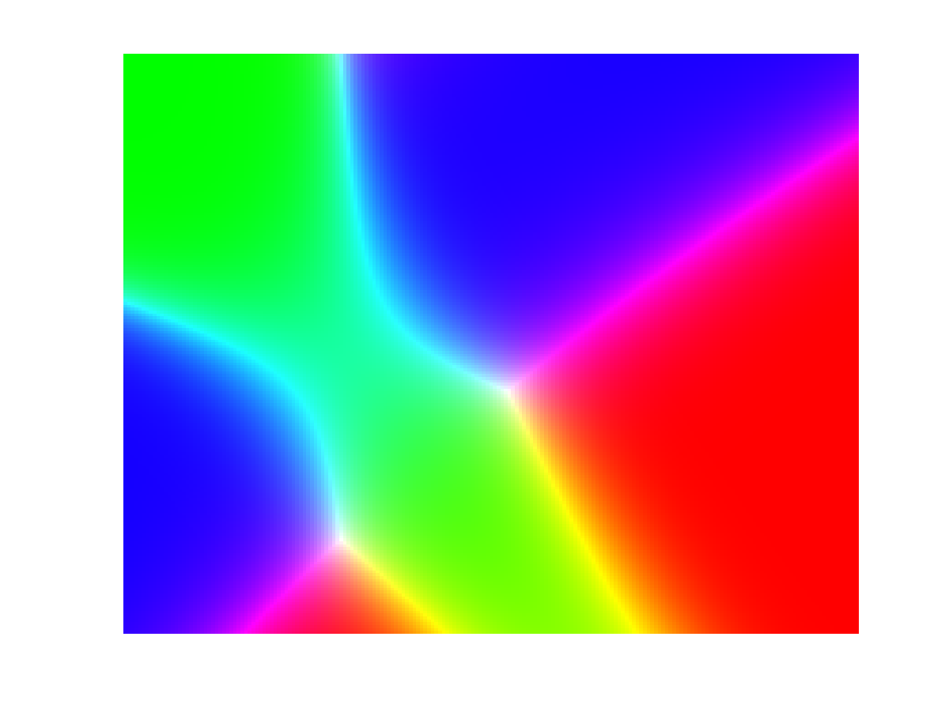
Generative models
As in the binary case:
Learn p(y) and p(y|x)
Use Bayes rule:
Classify as
p(y)
p(x|y)
p(y|x)

Slide 8
Generative models
Advantages:
  Fast to train: only the data from class k is needed to learn the k^{th} model (reduction by a factor k compared with other method)
  Works well with little data provided the model is reasonable
Drawbacks:
  Depends on the quality of the model
  Doesn’t model p(y|x) directly
  With a lot of datapoints doesn’t perform as well as discriminative methods

Slide 9
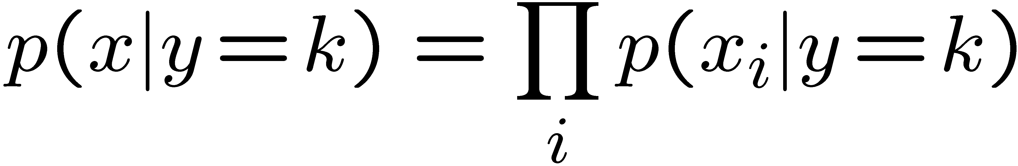
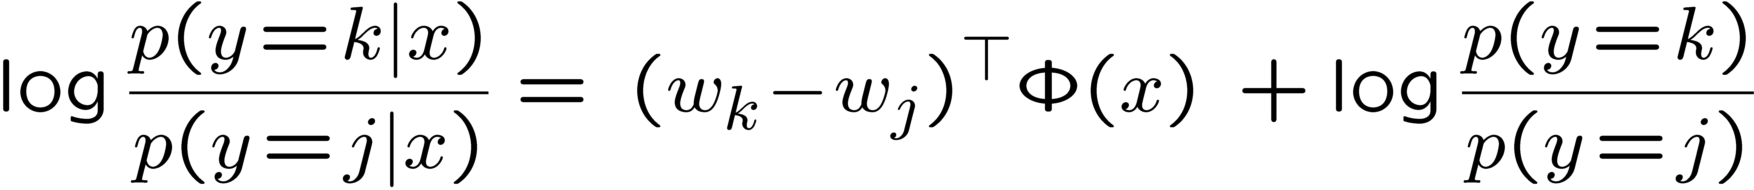
Naïve Bayes
Class
Assumption: Given the class the features are independent
Y
X₁
X₂
X₃
X₄
X₅
Features
Bag-of-words models
If the features are discrete:

Slide 10
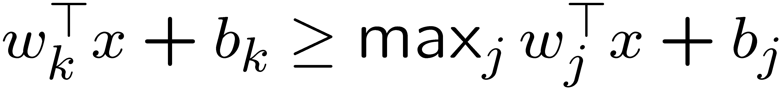
Linear classification
Each class has a parameter vector (w_{k},b_{k})
x is assigned to class k iff
Note that we can break the symmetry and choose (w₁,b₁)=0
For simplicity set b_{k}=0
(add a dimension and include it in w_{k})
So learning goal given separable data: choose w_{k} s.t.

Slide 11
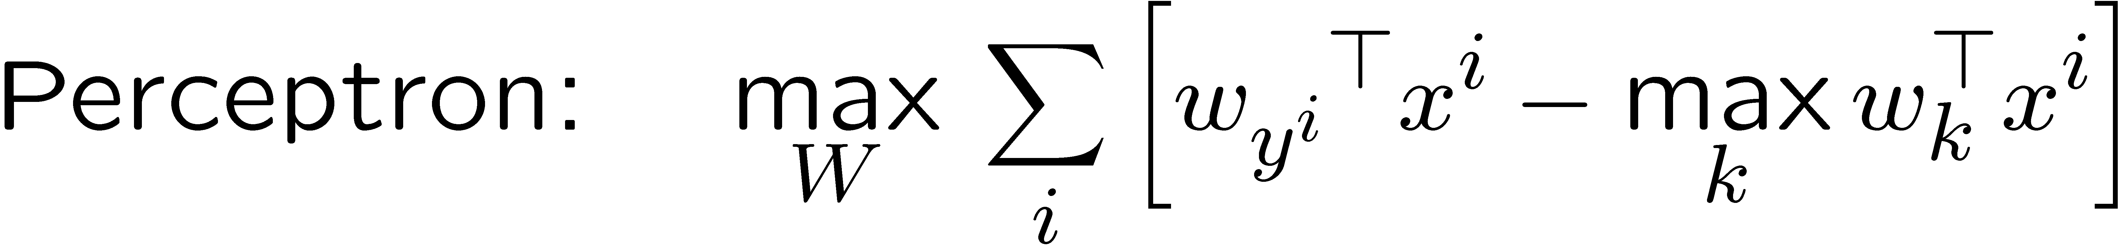
Three discriminative algorithms

Slide 12
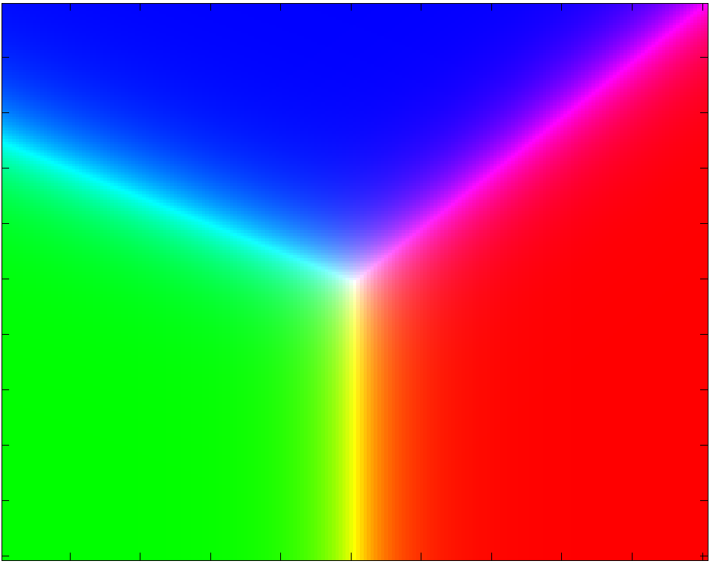
Geometry of Linear classification
Perceptron K-class logistic regression K-class SVM

Slide 13

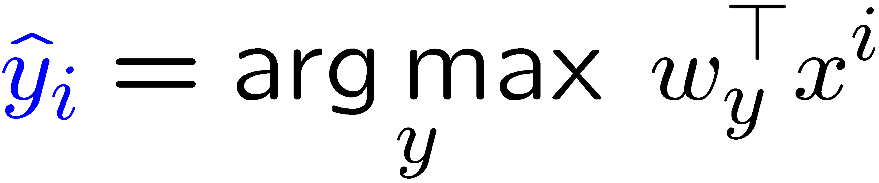
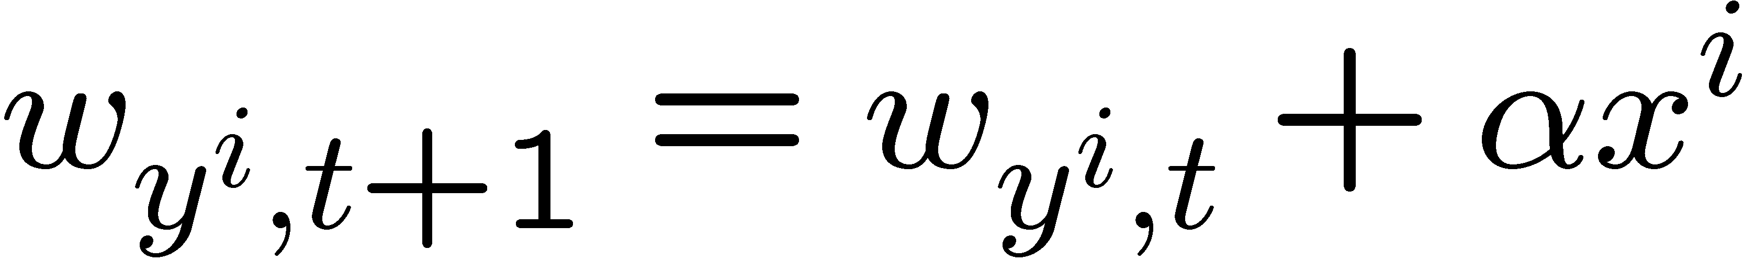
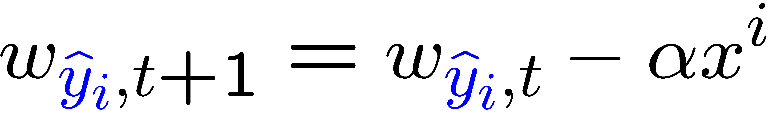
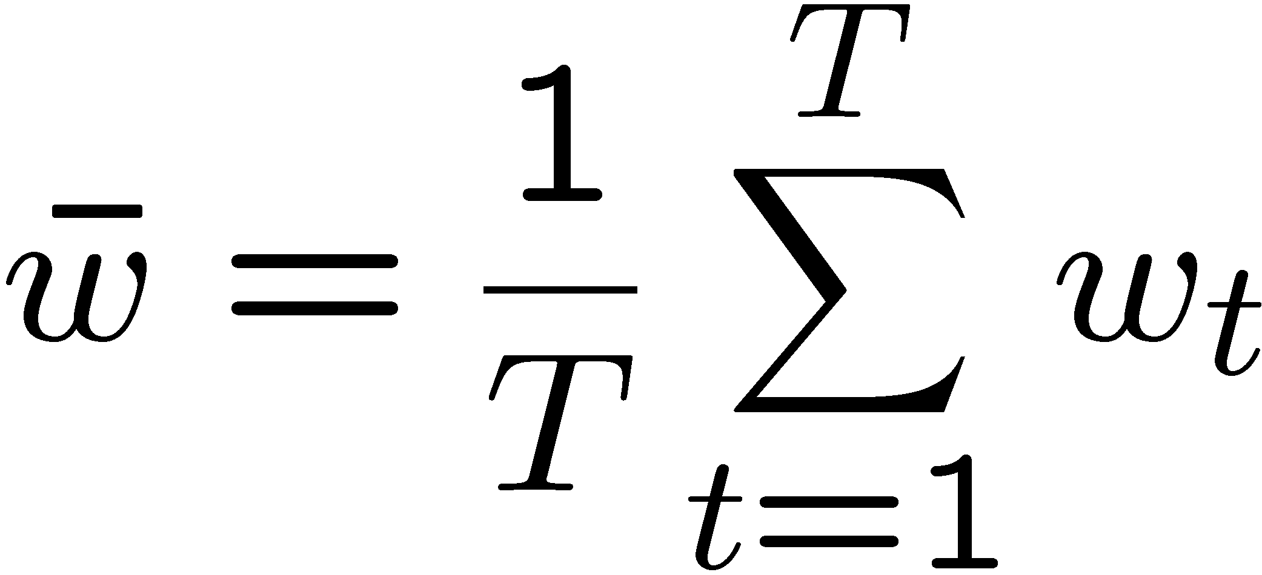
Multiclass Perceptron
Online: for each datapoint
Update:
Predict:
Advantages :
  Extremely simple updates (no gradient to calculate)
  No need to have all the data in memory (some point stay classified correctly after a while)
Drawbacks
  If the data is not separable decrease α slowly…

Slide 14
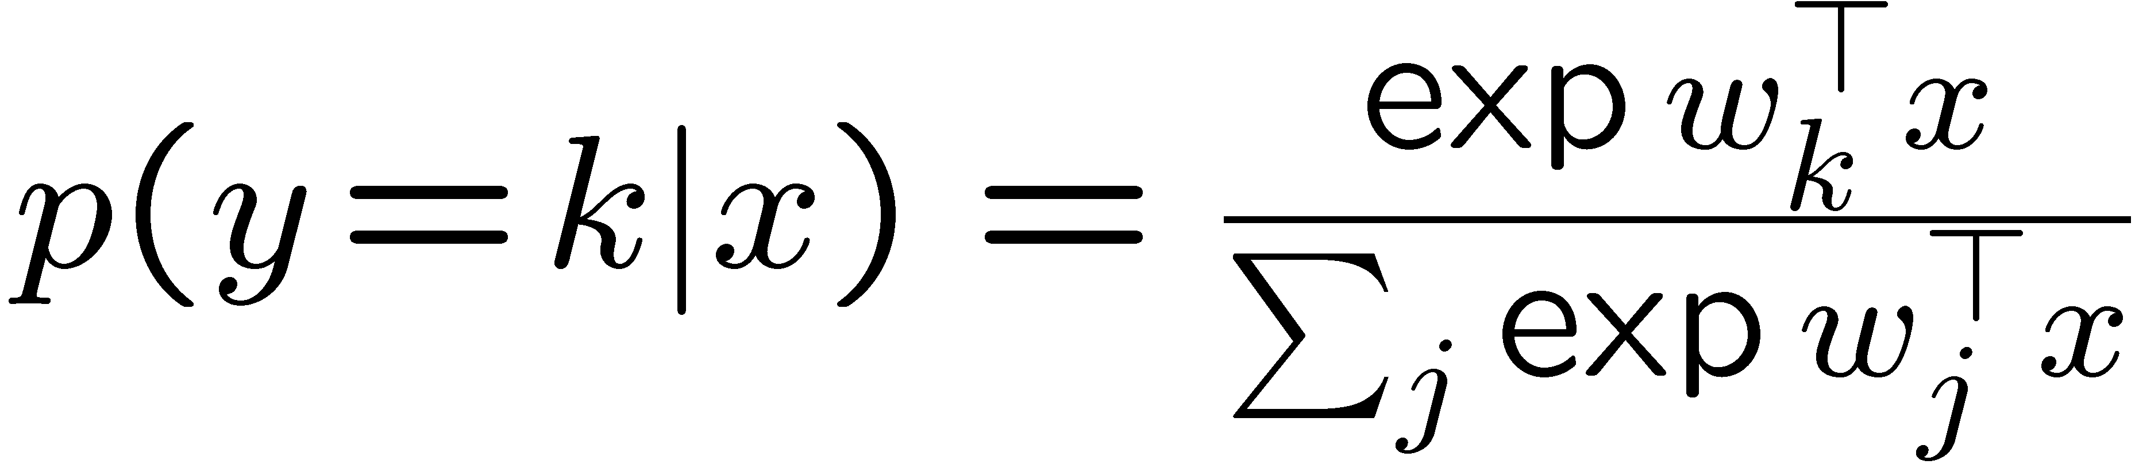

Polychotomous logistic regression
distribution in exponential form
Online: for each datapoint
Batch: all descent methods
Especially in large dimension, use regularization
small flip label probability (0,0,1) (.1,.1,.8)
Advantages:
Smooth function
Get probability estimates
Drawbacks:
Non sparse

Slide 15
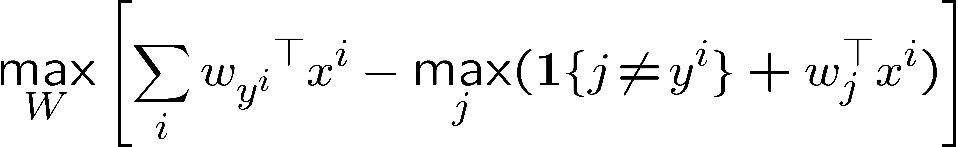
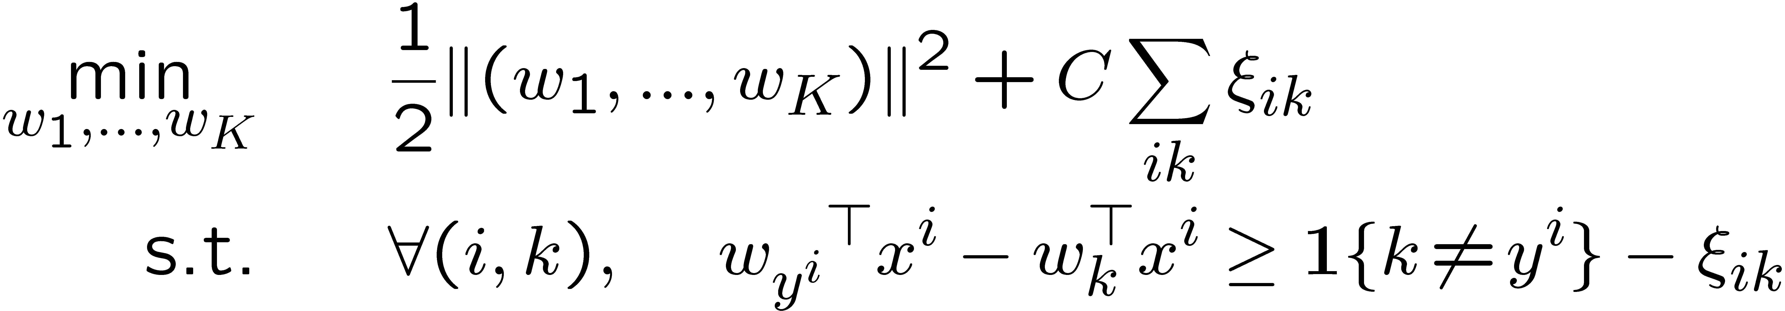
Multi-class SVM
Intuitive formulation: without regularization / for the separable case
Primal problem: QP
Solved in the dual formulation, also Quadratic Program
Main advantage: Sparsity (but not systematic)
Speed with SMO (heuristic use of sparsity)
Sparse solutions
Drawbacks:
Need to recalculate or store x_{i}^{T}x_{j}
Outputs not probabilities

Slide 16
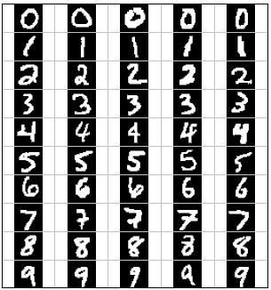
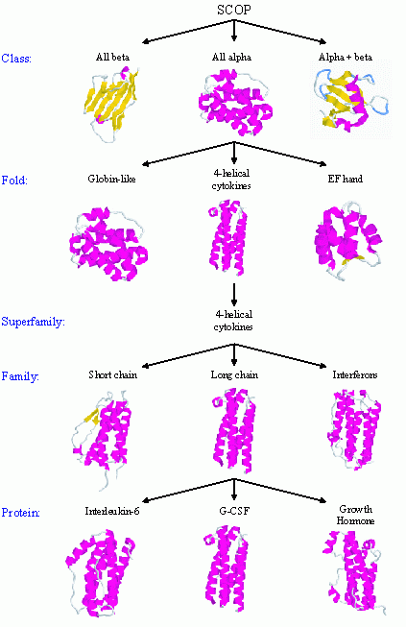
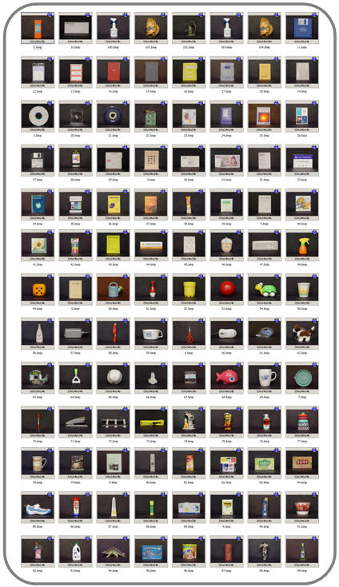
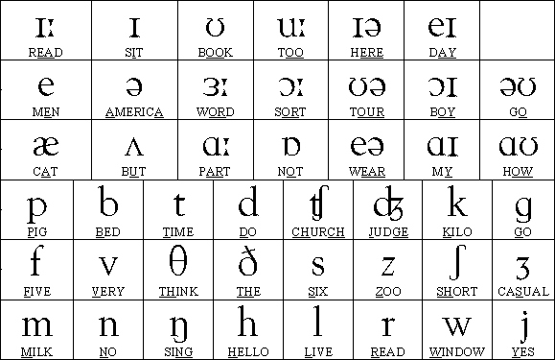
Real world classification problems
Digit recognition
Automated protein classification
Object recognition
http://www.glue.umd.edu/~zhelin/recog.html
10
Phoneme recognition
300-600
100
The number of classes is sometimes big
The multi-class algorithm can be heavy
50
[Waibel, Hanzawa, Hinton,Shikano, Lang 1989]

Slide 17
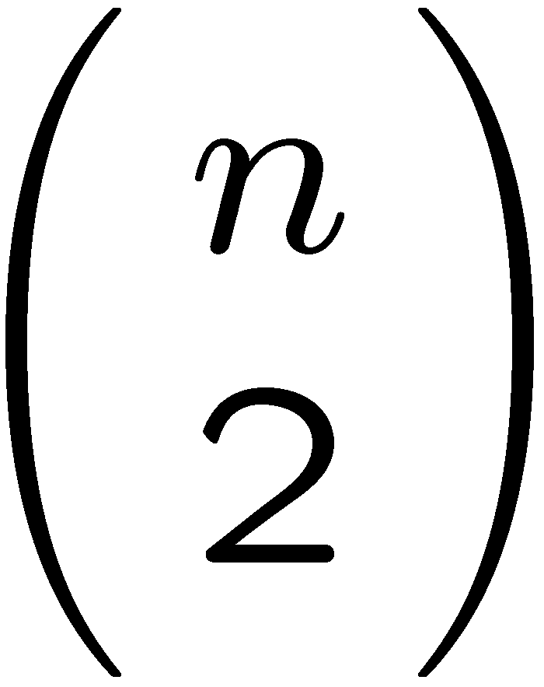
Combining binary classifiers
One-vs-all For each class build a classifier for that class vs the rest
Often very imbalanced classifiers (use asymmetric regularization)
All-vs-all For each class build a classifier for that class vs the rest
A priori a large number of classifiers to build but…
  The pairwise classification are way much faster
  The classifications are balanced (easier to find the best regularization)
… so that in many cases it is clearly faster than one-vs-all

Slide 18
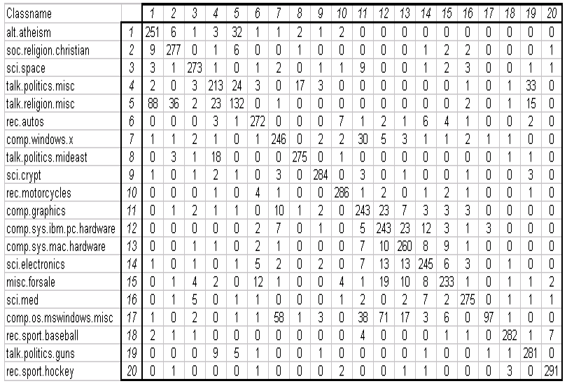
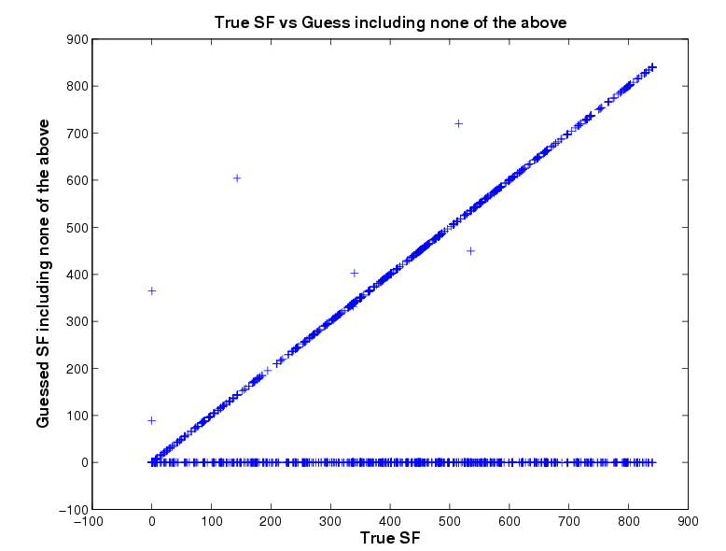
Confusion Matrix
Classification of 20 news groups
Predicted classes
Visualize which classes are more difficult to learn
Can also be used to compare two different classifiers
Cluster classes and go hierachical [Godbole, ‘02]
Actual classes
[Godbole, ‘02]
BLAST classification of proteins in 850 superfamilies

Slide 19
Calibration
How to measure the confidence in a class prediction?
Crucial for:
Comparison between different classifiers
Ranking the prediction for ROC/Precision-Recall curve
In several application domains having a measure of confidence for each individual answer is very important (e.g. tumor detection)
Some methods have an implicit notion of confidence e.g. for SVM the distance to the class boundary relative to the size of the margin other like logistic regression have an explicit one.
Notes:
Want universal confidence score for different methods…

Slide 20
Calibration
Definition: the decision function f of a classifier is said to be calibrated or well-calibrated if
Informally f is a good estimate of the probability of classifying correctly a new datapoint x which would have output value x.
Intuitively if the “raw” output of a classifier is g you can calibrate it by estimating the probability of x being well classified given that g(x)=y for all y values possible.

Slide 21
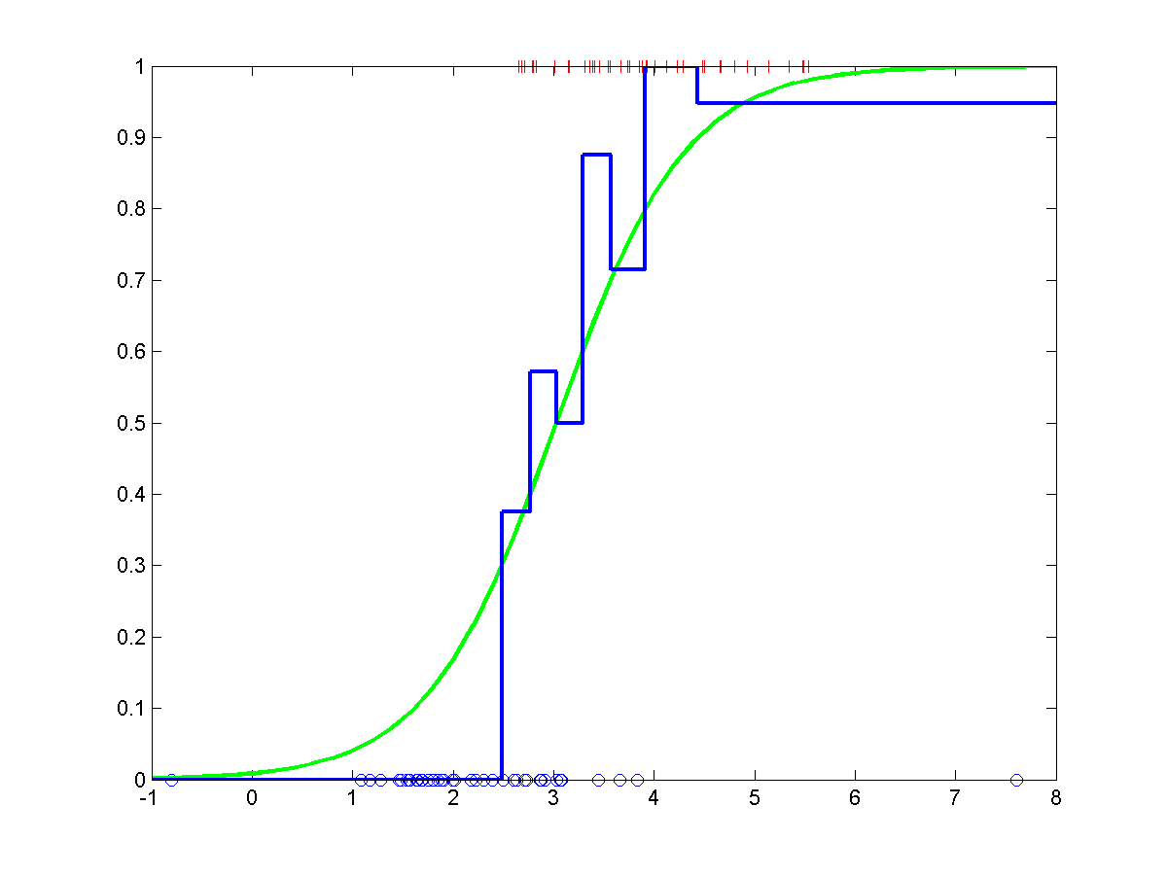
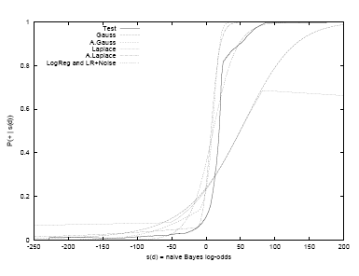
Calibration
Example: a logistic regression, or more generally calculating a Bayes posterior should yield a reasonably well-calibrated decision function.

Slide 22
Combining OVA calibrated classifiers
Class 1
Class 2
Class 3
Class 4
+
+
+
+
+
+
+
+
+
+
+
+
+
+
+
+
+
+
+
+
+
+
+
+
+
+
+
+
+
+
+
+
+
+
+
+
+
+
+
+
+
+
+
+
+
+
+
+
+
+
+
+
+
+
+
+
+
+
+
+
+
+
+
+
Calibration
p₁
p₂
p₃
p₄
Renormalize
p_{other}
consistent (p₁,p₂,…,p₄,p_{other})

Slide 23
Other methods for calibration
Simple calibration
  Logistic regression
  Intraclass density estimation + Naïve Bayes
  Isotonic regression
More sophisticated calibrations
  Calibration for A-vs-A by Hastie and Tibshirani

Slide 24
Structured classification

Slide 25


Local Classification
b
r
a
r
e
Classify using local information
⇒ Ignores correlations!
[thanks to Ben Taskar for slide!]

Slide 26
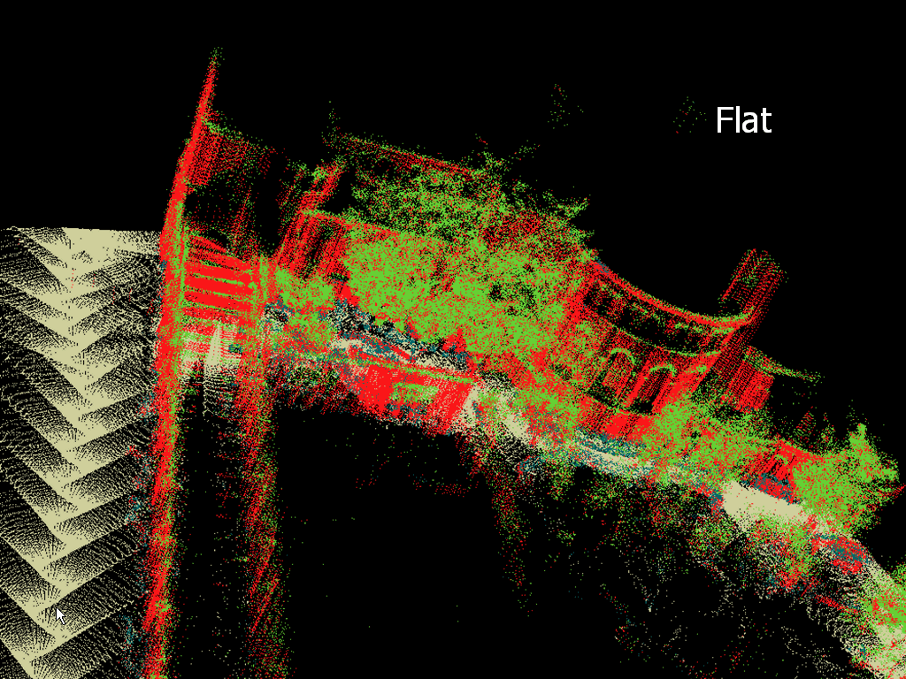

Local Classification
building
tree
shrub
ground
[thanks to Ben Taskar for slide!]
Notes:
Let’s look at the output.
Look at majority of the pixels. Roughly correct. In fact, around 70% accuracy.
However, there are some serious problems

Slide 27
Structured Classification
b
r
a
c
e
Use local information
Exploit correlations
[thanks to Ben Taskar for slide!]

Slide 28
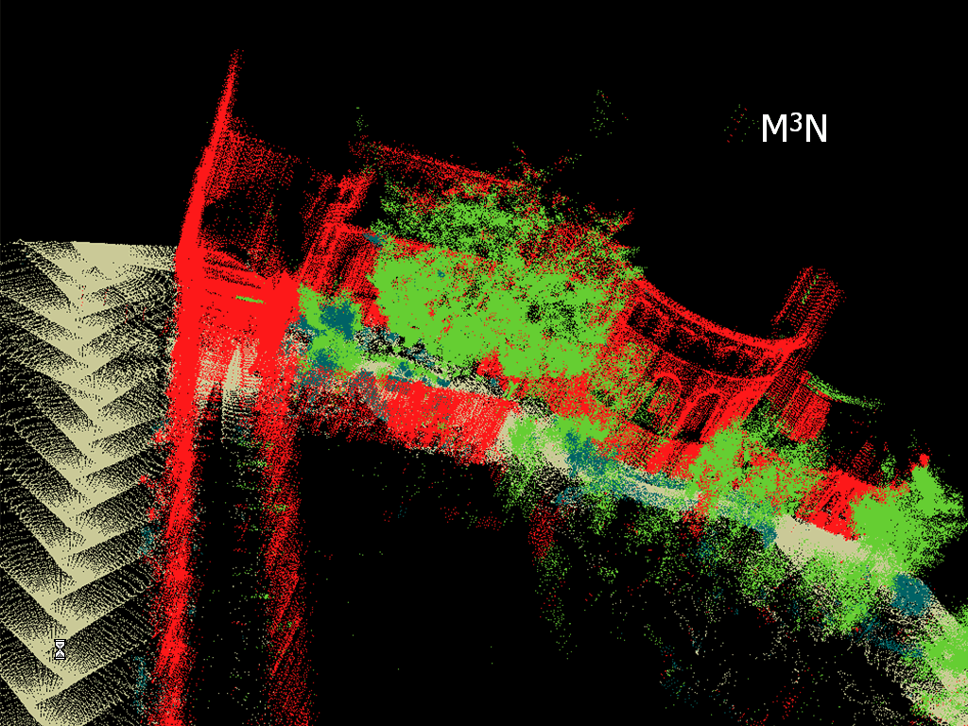

Structured Classification
building
tree
shrub
ground
[thanks to Ben Taskar for slide!]

Slide 29
Structured Classification
Structured classification : direct approaches
  Generative approach: Markov Random Fields (Bayesian modeling with graphical models)
  Linear classification:
    Structured Perceptron
    Conditional Random Fields (counterpart of logistic regression)
    Large-margin structured classification

Slide 30









Structured classification
Simple example HMM:
“Label sequence”
“Observation sequence”
b r a c e
Optical Character Recognition

Slide 31
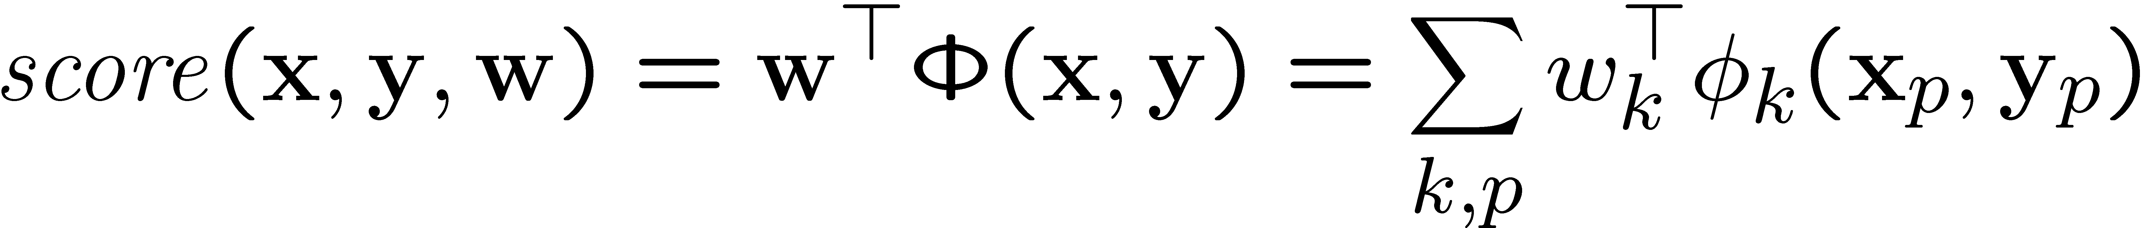
Structured Model
Main idea: define scoring function which decomposes as sum of features scores k on “parts” p:
Label examples by looking for max score:
Parts = nodes, edges, etc.
space of feasible outputs

Slide 32




Tree model 1
“Label structure”
“Observations”

Slide 33






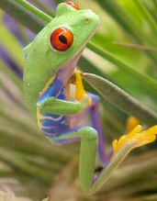
Tree model 1
Eye color inheritance:
haplotype inference
Notes:
Haplotype = genotype + order of strands

Slide 34
Tree Model 2:
Hierarchical Text Classification
Root
Arts
Business
Computers
Cannes Film Festival schedule .... .... .... ... .. ...... ..
..... ...........
Movies
Television
Internet
Software
Jobs
Real Estate
Y: label in tree
(from ODP)
X: webpage

Slide 35
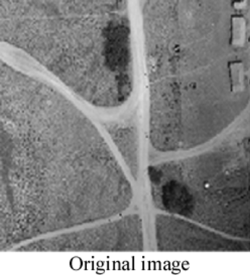
Grid model
Image segmentation
Segmented = “Labeled” image

Slide 36
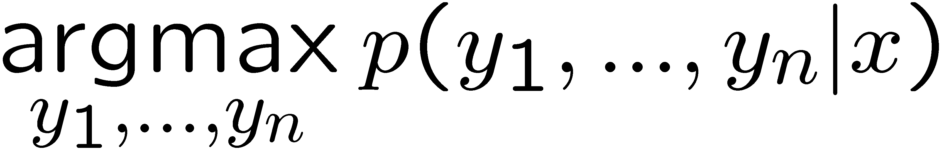
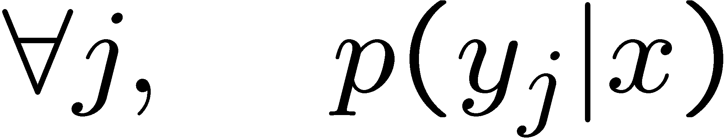
Decoding and Learning
Three important operations on a general structured (e.g. graphical) model:
Decoding: find the right label sequence
Inference: compute probabilities of labels
Learning: find model + parameters w so that decoding works
b r a c e
HMM example:
Decoding: Viterbi algorithm
Inference: forward-backward algorithm
Learning: e.g. transition and emission counts (case of learning a generative model from fully labeled training data)

Slide 37
Decoding and Learning
Decoding: algorithm on the graph (eg. max-product)
Inference: algorithm on the graph (eg. sum-product, belief propagation, junction tree, sampling)
Learning: inference + optimization
Use dynamic programming to take advantage of the structure
Focus of graphical model class
Need 2 essential concepts:
  cliques: variables that directly depend on one another
  features (of the cliques): some functions of the cliques

Slide 38
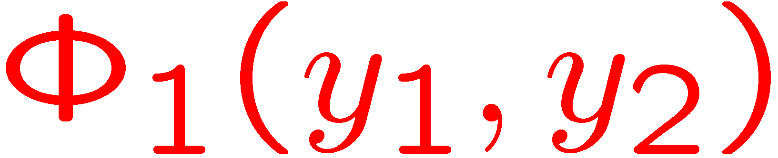
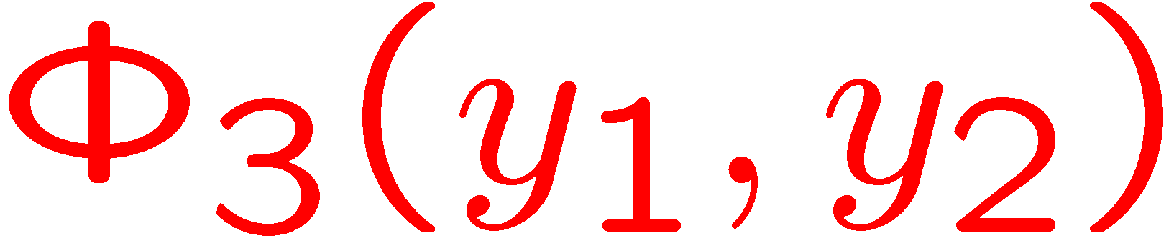

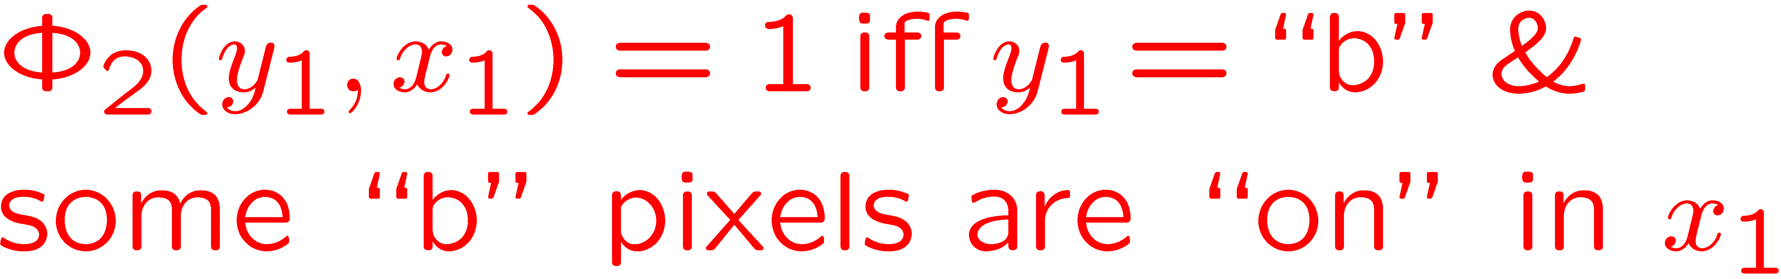

Cliques and Features
b r a c e
b r a c e
In undirected graphs:
cliques = groups of completely interconnected variables
In directed graphs:
cliques = variable+its parents

Slide 39
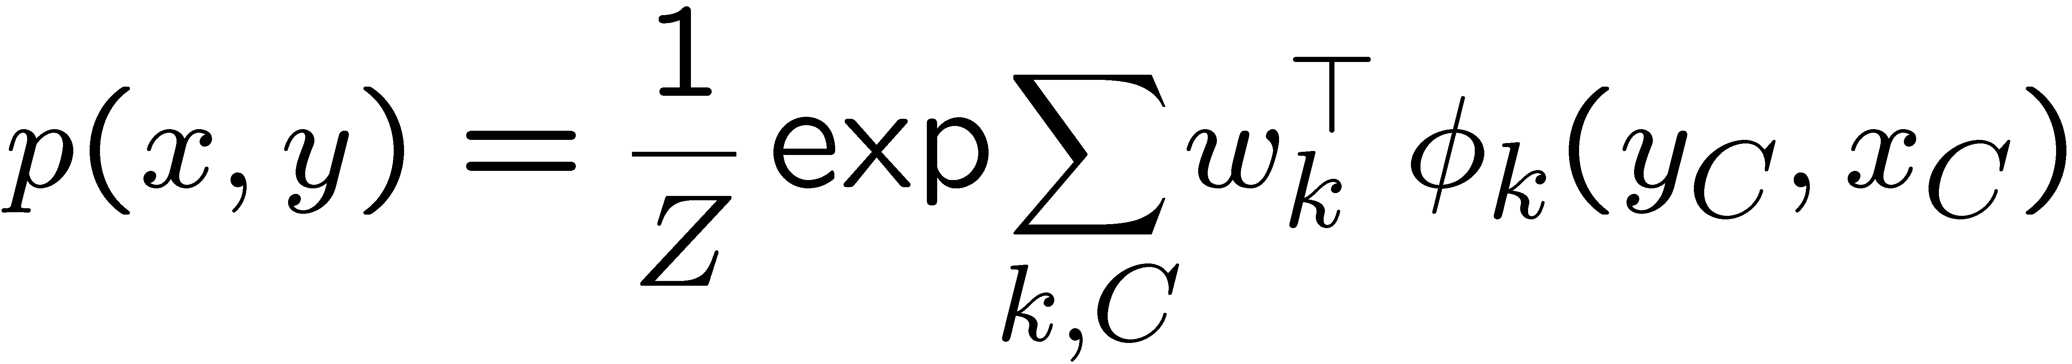
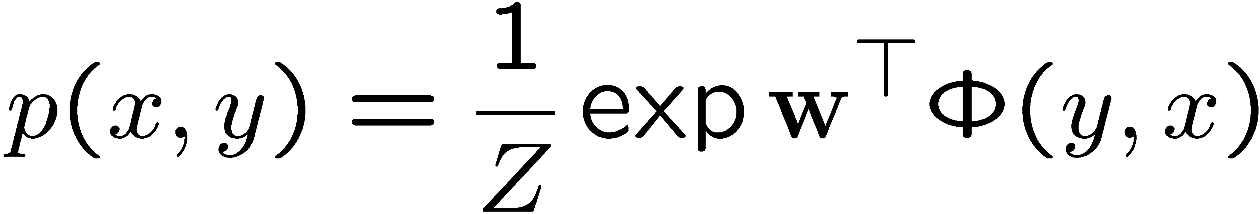
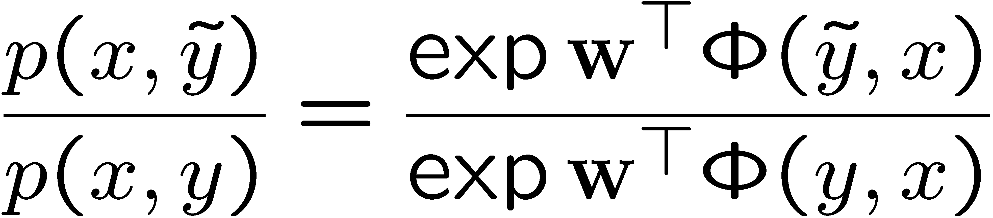
Exponential form
Once the graph is defined the model can be written in exponential form
parameter vector
feature vector
Comparing two labellings with the likelihood ratio

Slide 40
Our favorite (discriminative) algorithms
……

Slide 41
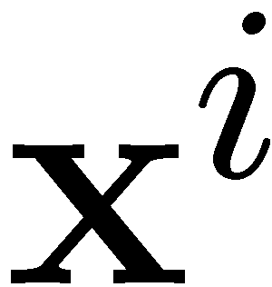
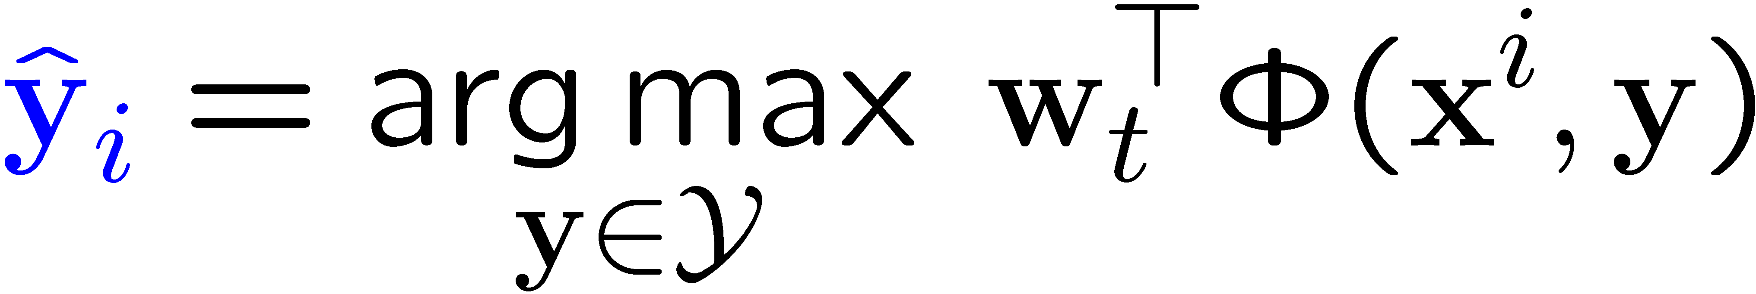
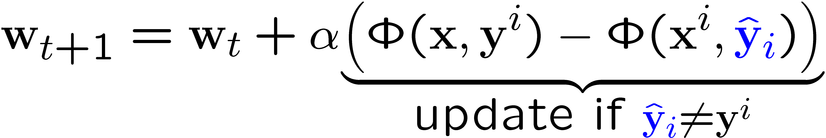
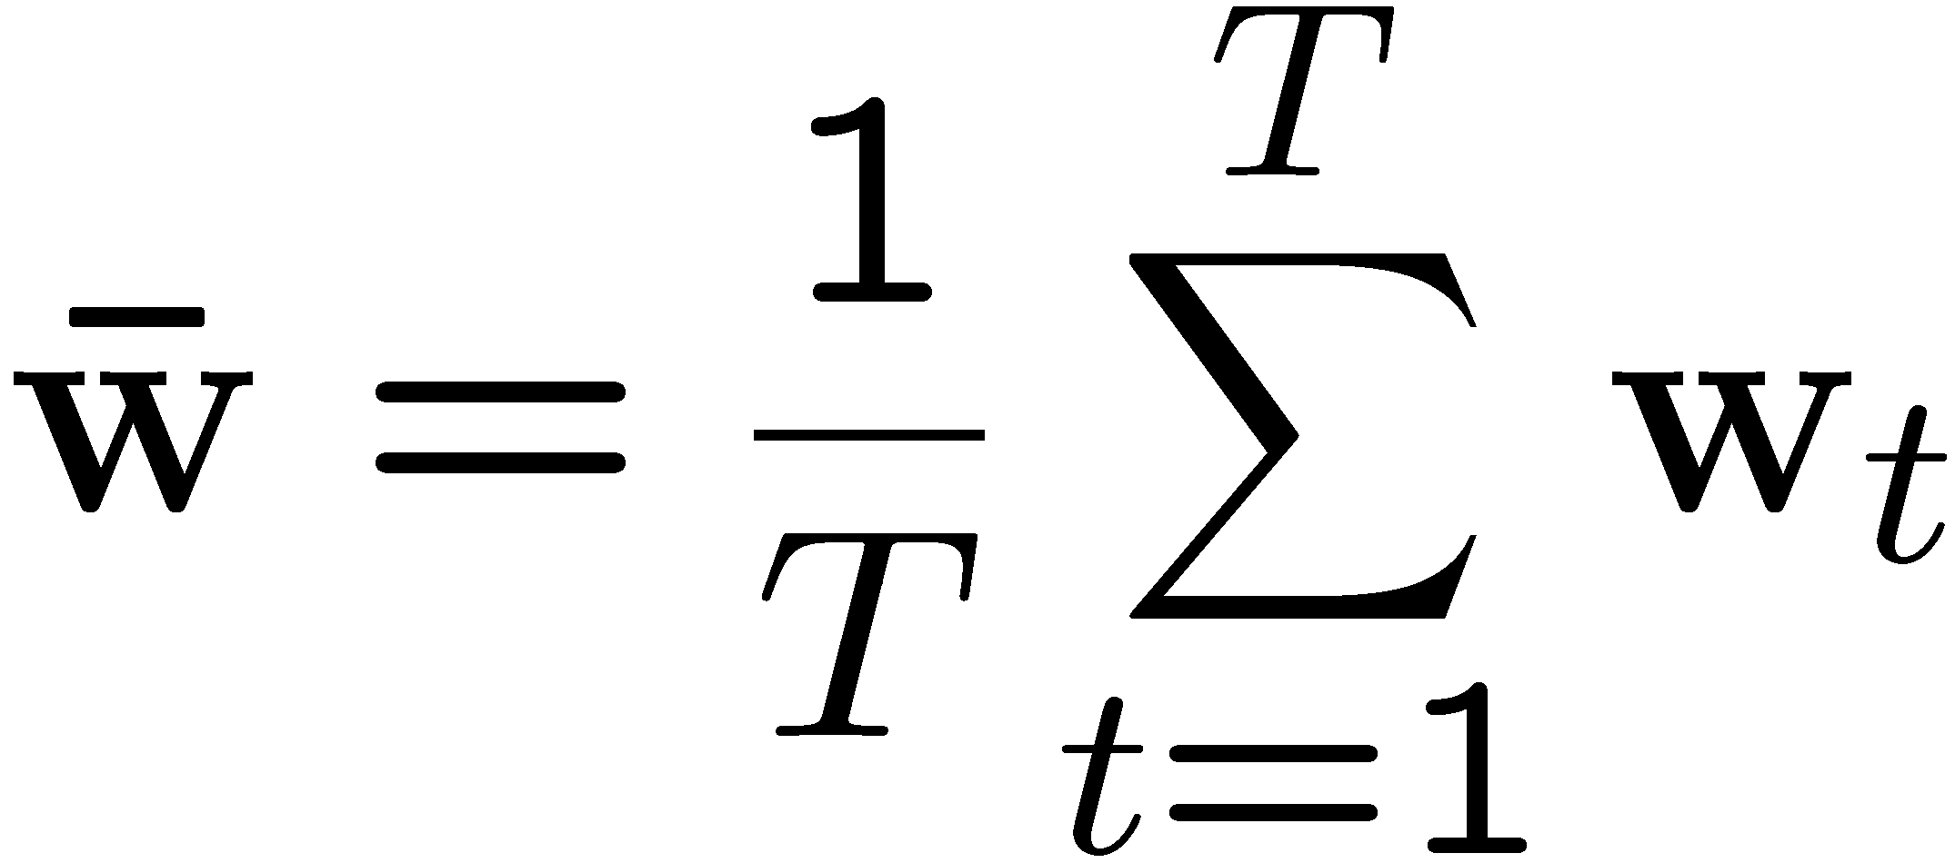
(Averaged) Perceptron
For each datapoint
Predict:
Update:
Averaged perceptron:

Slide 42
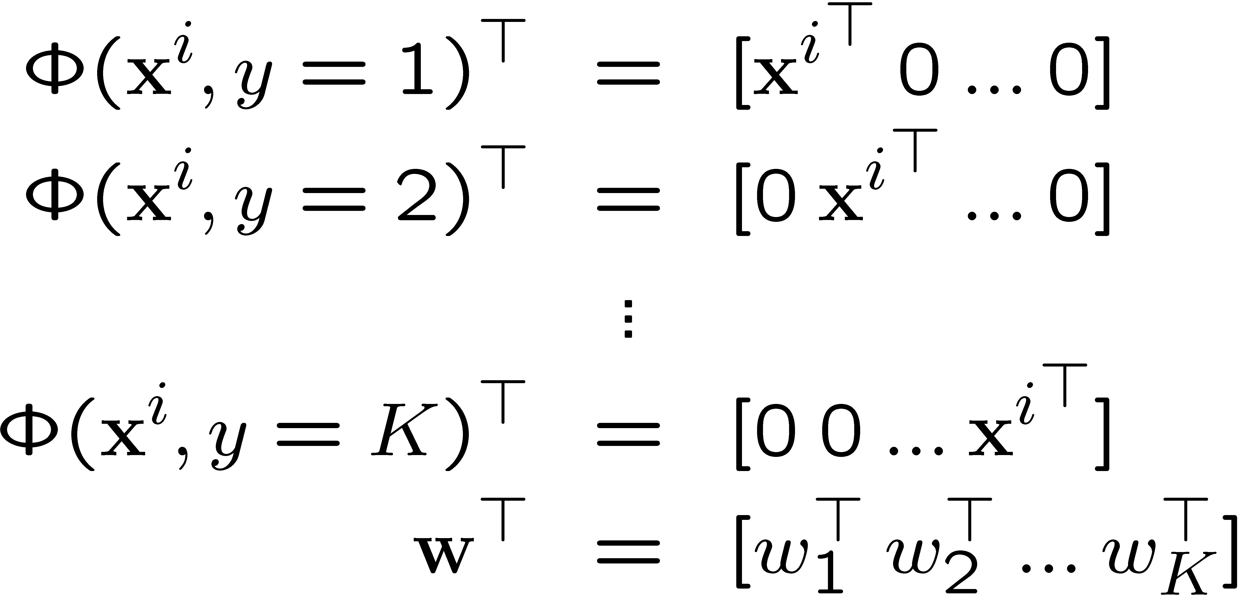
Example: multiclass setting
Feature encoding:
Predict:
Update:
Predict:
Update:

Slide 43
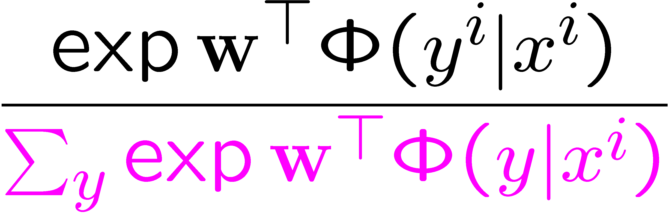
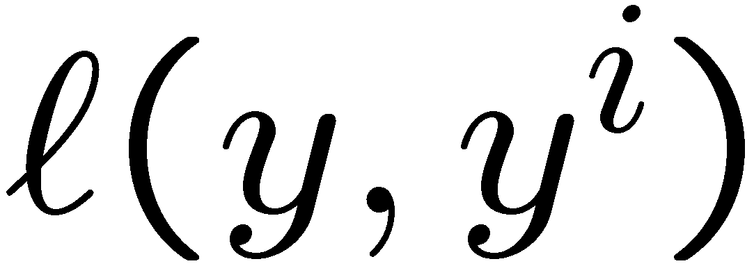
CRF
Z difficult to compute with complicated graphs
Conditioned on all the observations
Introduction by Hannah M.Wallach
http://www.inference.phy.cam.ac.uk/hmw26/crf/
MEMM & CRF, Mayssam Sayyadian, Rob McCann
anhai.cs.uiuc.edu/courses/498ad-fall04/local/my-slides/crf-students.pdf
M³net
No Z …
The margin penalty can “factorize” according to the problem structure
Introduction by Simon Lacoste-Julien
http://www.cs.berkeley.edu/~slacoste/school/cs281a/project_report.html

Slide 45
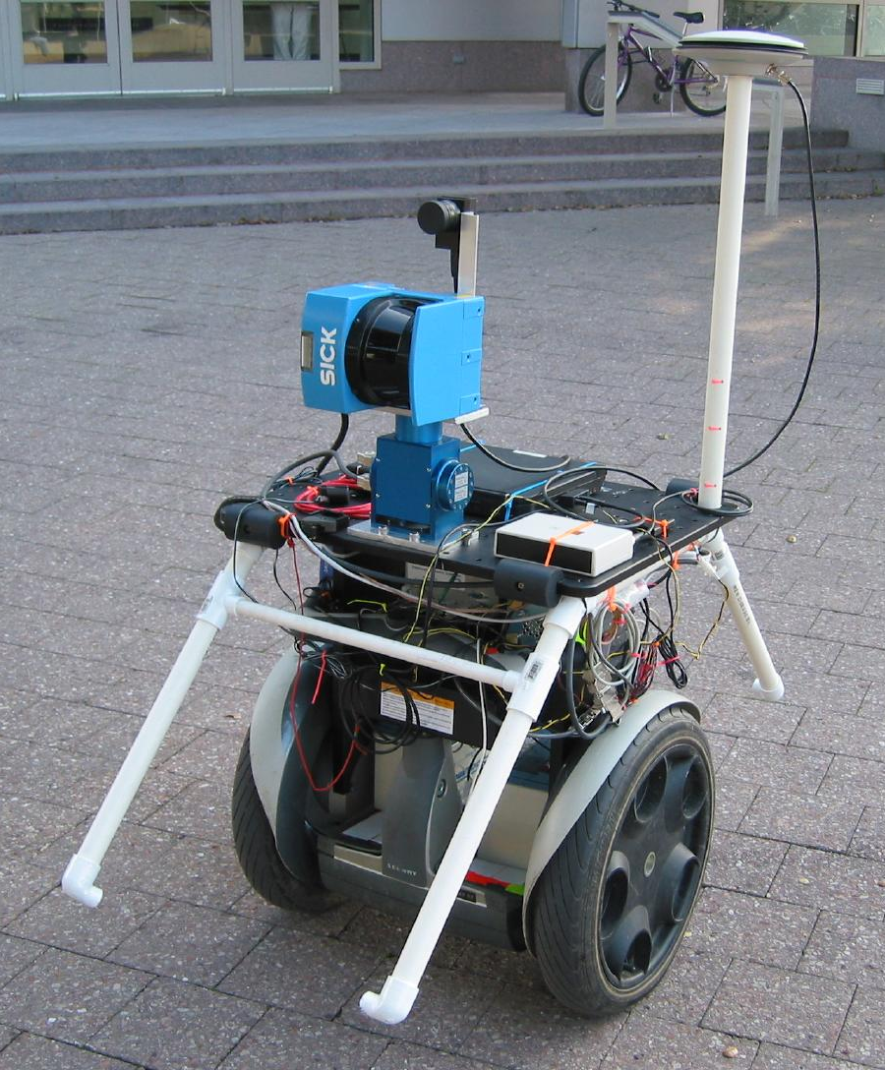
Object Segmentation Results
[thanks to Ben Taskar for slide!]
Data: [Stanford Quad by Segbot]
Trained on 30,000 point scene
Tested on 3,000,000 point scenes
Evaluated on 180,000 point scene
Laser Range Finder
Segbot
M. Montemerlo
S. Thrun
Model | Error
Local learning Local prediction | 32%
Local learning +smoothing | 27%
Structured method | 7%
building
tree
shrub
ground
[Taskar+al 04,
Anguelov+Taskar+al 05]

